Slide 1
Reconocimiento de cónicas

Slide 2
$$Ax^{2}+By^{2}+Dx+Ey+F=0$$
Si $A = B$ (ambos no nulos): puede definir una circunferencia
Si $A ≠ B$ y de igual signo (ambos no nulos): puede definir una elipse
Si $A ≠ B$ y de distinto signo (ambos no nulos): define una hipérbola
Si $A=0∨B=0$: define una parábola

Slide 3
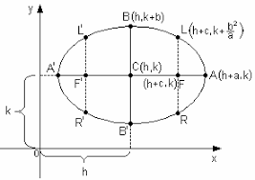
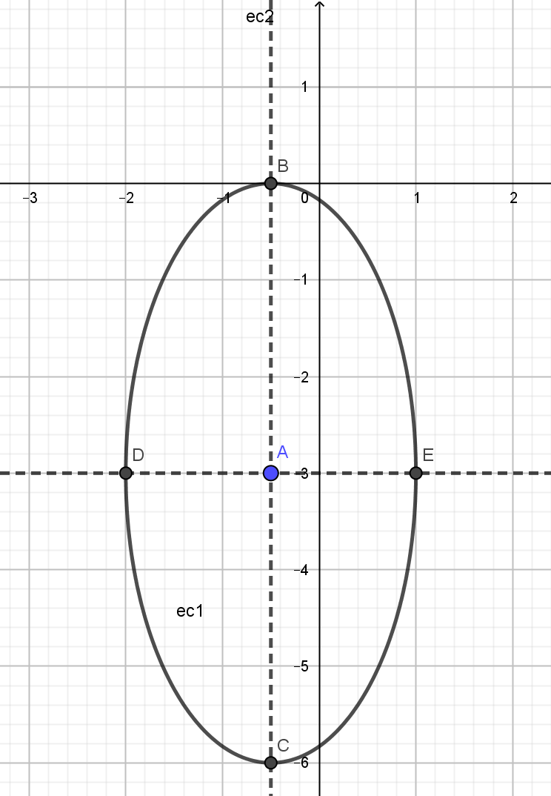
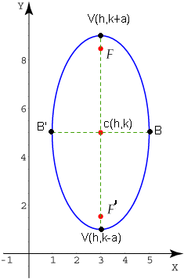


$$\frac{{\left(x−h\right)}^{2}}{a^{2}}+\frac{{\left(y−k\right)}^{2}}{b^{2}}=1$$
$$\frac{{\left(x−h\right)}^{2}}{b^{2}}+\frac{{\left(y−k\right)}^{2}}{a^{2}}=1$$

Slide 4
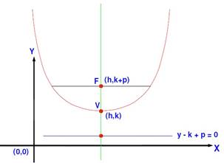
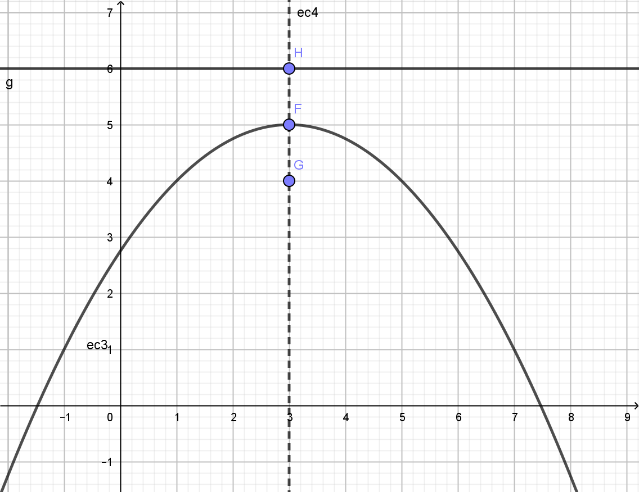
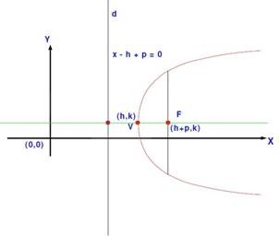


$$y−k=\frac{1}{4p}{\left(x−h\right)}^{2}$$
$$x−h=\frac{1}{4p}{\left(y−k\right)}^{2}$$

Slide 5
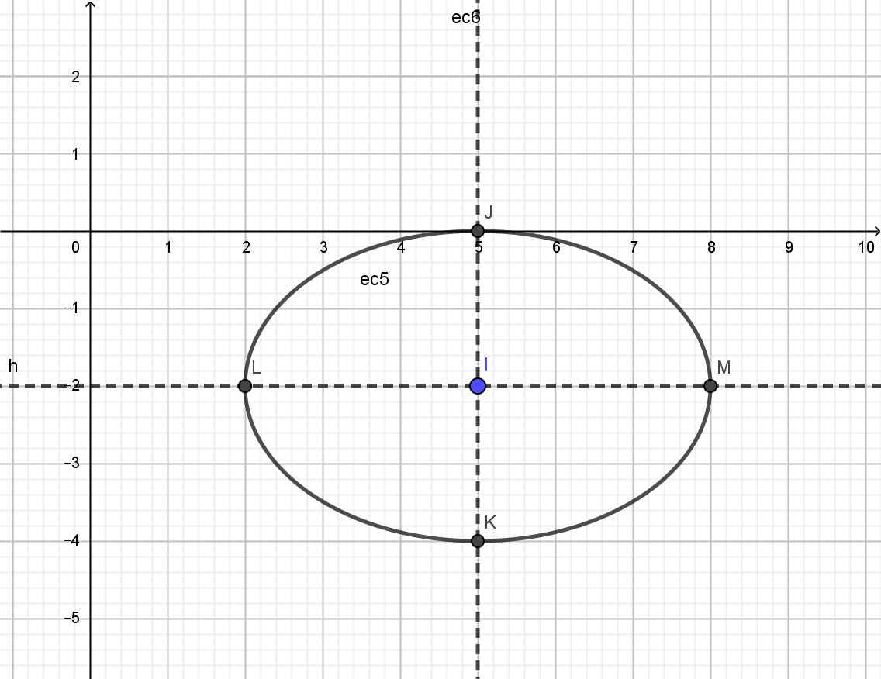
$$\frac{{\left(x−h\right)}^{2}}{a^{2}}+\frac{{\left(y−k\right)}^{2}}{b^{2}}=1$$
$$\frac{{\left(x−h\right)}^{2}}{b^{2}}+\frac{{\left(y−k\right)}^{2}}{a^{2}}=1$$

Slide 6
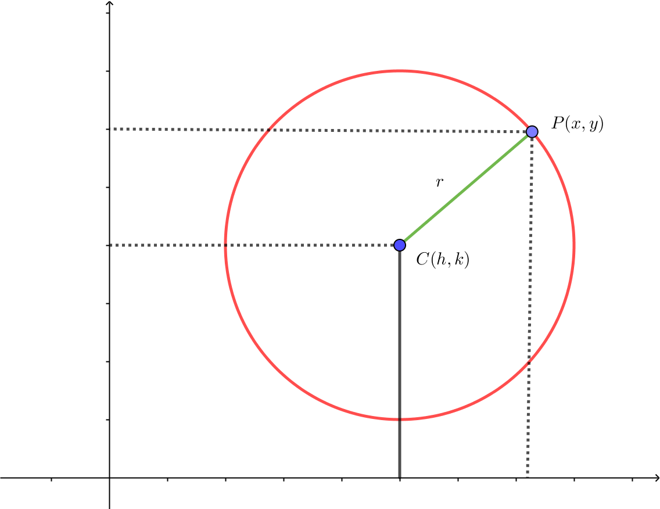

$${\left(x−h\right)}^{2}+{\left(y−k\right)}^{2}=r^{2}$$

Slide 7
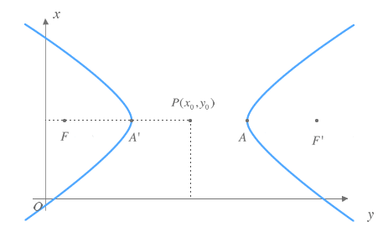
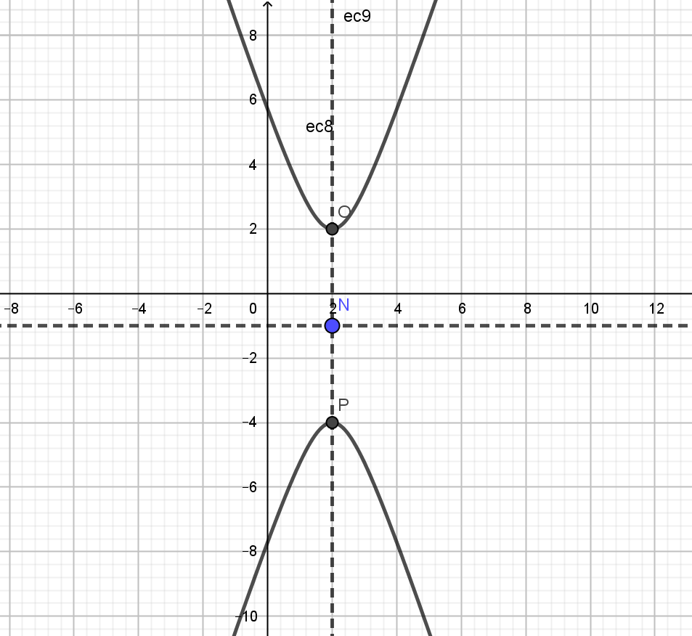
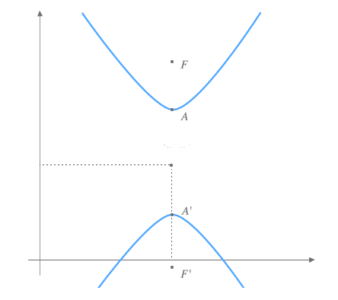
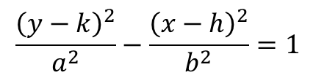
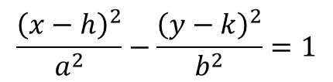
$$\frac{{\left(x−h\right)}^{2}}{a^{2}}−\frac{{\left(y−k\right)}^{2}}{b^{2}}=1$$
$$\frac{{\left(y−k\right)}^{2}}{a^{2}}−\frac{{\left(x−h\right)}^{2}}{b^{2}}=1$$

Slide 8
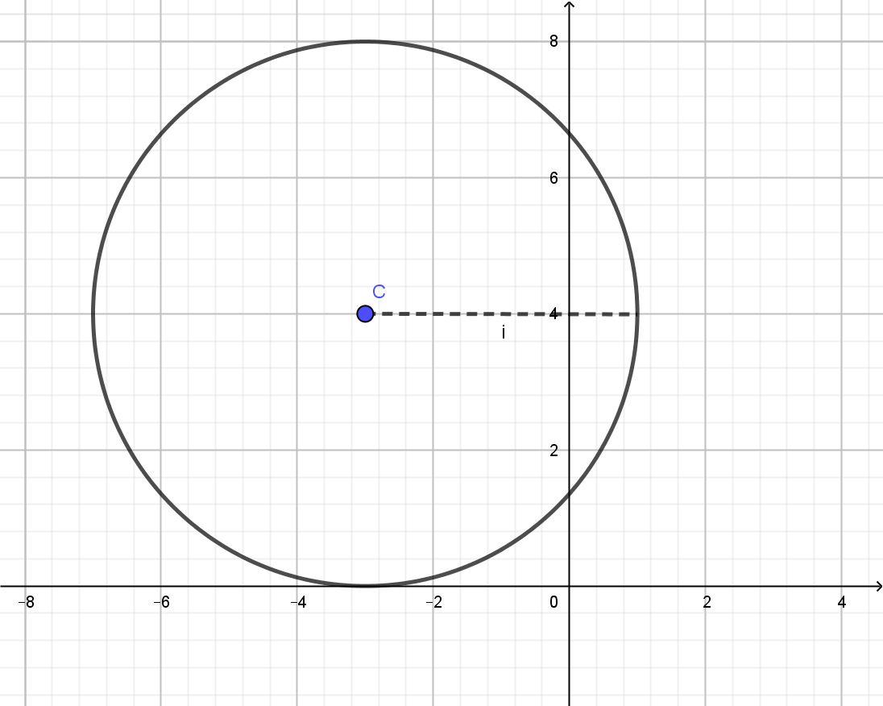
$${\left(x−h\right)}^{2}+{\left(y−k\right)}^{2}=r^{2}$$

Slide 9
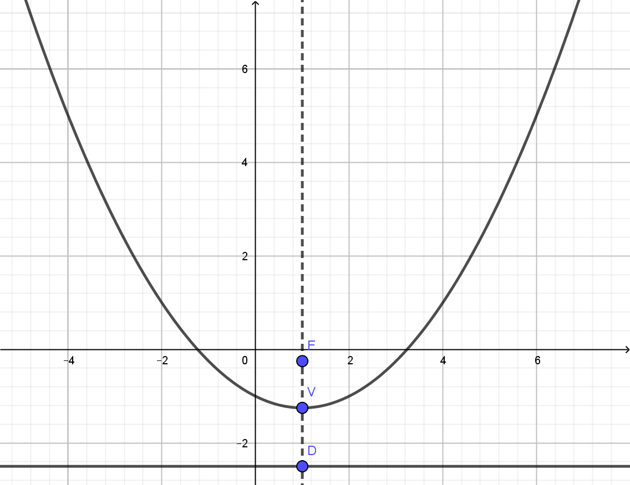
$$y−k=\frac{1}{4p}{\left(x−h\right)}^{2}$$
$$x−h=\frac{1}{4p}{\left(y−k\right)}^{2}$$

Slide 10
$$\frac{{\left(x−h\right)}^{2}}{a^{2}}+\frac{{\left(y−k\right)}^{2}}{b^{2}}=1$$
$$\frac{{\left(x−h\right)}^{2}}{b^{2}}+\frac{{\left(y−k\right)}^{2}}{a^{2}}=1$$

Slide 11
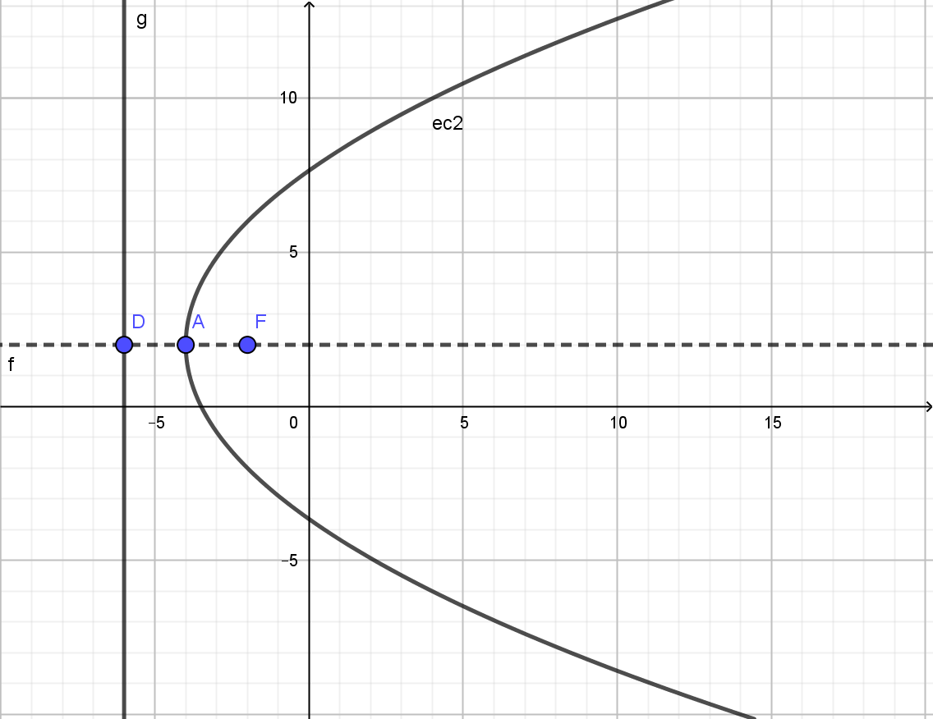


$$y−k=\frac{1}{4p}{\left(x−h\right)}^{2}$$
$$x−h=\frac{1}{4p}{\left(y−k\right)}^{2}$$

